Slide 1


Slide 2
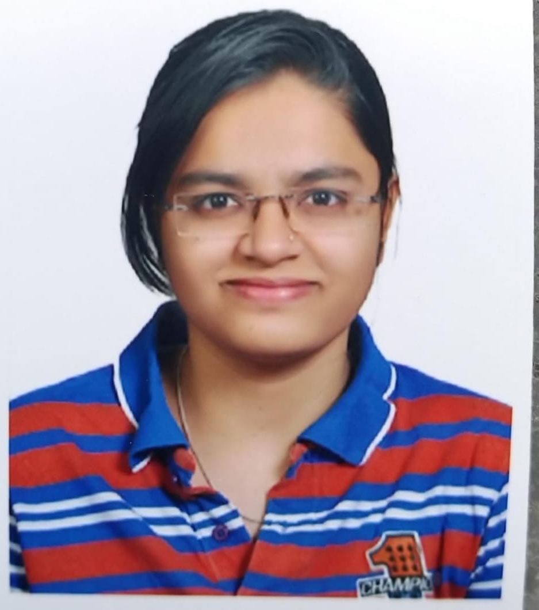
Project Highlights
Project Name :Olympic Data Analysis
Team Size: 1
BU Mentor Name :Kavitha Guruprasad
Rajesh Sola
Shivani Khamitkar
99002657
GENESIS 2009BLRMED01
BE(EXTC)

Slide 3
Implementation C++ and LINUX PROJECT
The input file given was .csv file.
The .csv file contains data set of the countries winning medals in swimming. Read the .csv file.
If the path given is right,start parsing the file if path is not given correct give an error that path not found or file not found.
Parse through country and medal column.

Slide 4
C++ and LINUX PROJECT
Count the medals of the country.
Extract the country with the most gold medal.
Display the country name with most gold medals in the sport. Extract the country with the most silver medal.
Display the country name with most gold medals in the sport.
Extract the country with the most bronze medal. Display the country name with most gold medals in the sport.
Various Linux concepts like Semaphore, Mutex and threads were used in implementing the project.

Slide 5
Project Video Snippet
CPP_VIDEO

Slide 6
Future development that can be implemented further
Expansion of this project can be done by including different form of sports as this scripts analysis only one sport that is swimming hence by adding different sports we can analysis different sports using same script

Slide 7


Thank You !

